Slide 1
Organisms of Steeple Woods

Slide 2
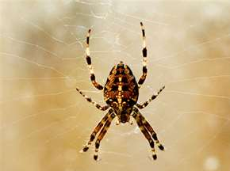
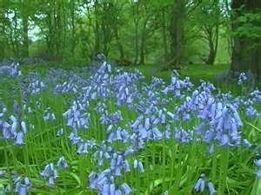
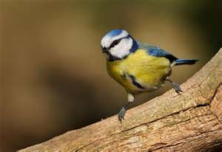
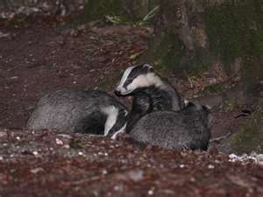
What organisms can be found in Woodland
Invertebrates
Plant life
Birds
Mammals

Slide 3
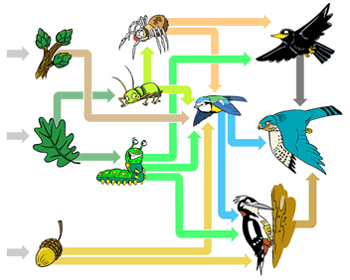
Woodland Food Web
What can you tell from this diagram?

Slide 4
Bird life in Woodland
Birds are one of main predators in the Woodland Food Web
Birds can be the top predator in a Woodland Food Web
Majority of birds feed on invertebrates during the summer period
Some birds feed on other birds, these are called Birds of Prey or Raptors

Slide 5
Hypothesis: There are more birds on the trees than on the ground.
Task: For the next 30 minutes, we are going to Steeple Woods to find examples of bird life. Use the Identification Keys given to you to identify the birds you see. While doing the task think about:
  where the birds have been seen and whether your observations support the above hypothesis
  where the invertebrates are in the woods. They provide an important food source for many bird species.

Slide 6
Hypothesis: There are more birds on the trees than on the ground.
Task: Write a paragraph stating whether or not the hypotheses supported by your observations. Think about:
  The invertebrates in the woods. Are they on the ground or on the tree bark?
  Why are the birds adapted to the woodland environment? Body size, colour, beak shape, etc.
  The protection from predators.

